Slide 1
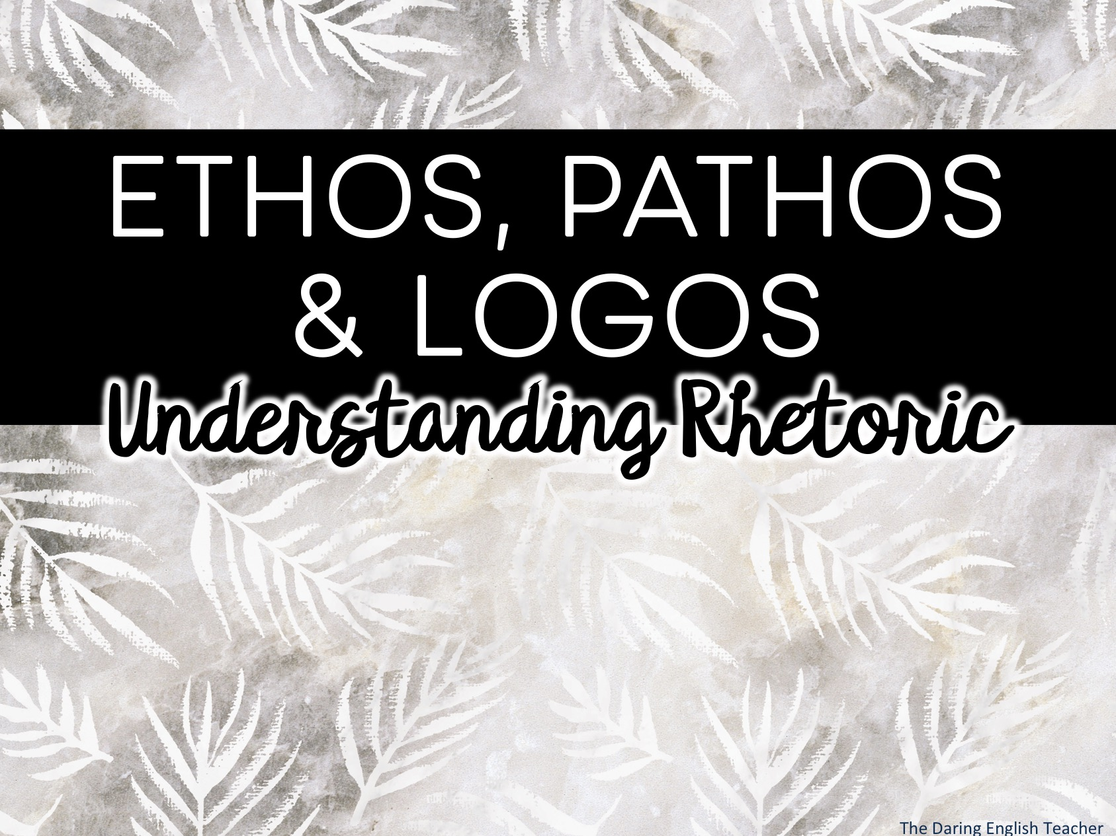
ETHOS, PATHOS & LOGOS
Understanding Rhetoric

Slide 2
What is Rhetoric?
Rhetoric (n) – the art of speaking or writing effectively
*What does effectively mean to you?

Slide 3
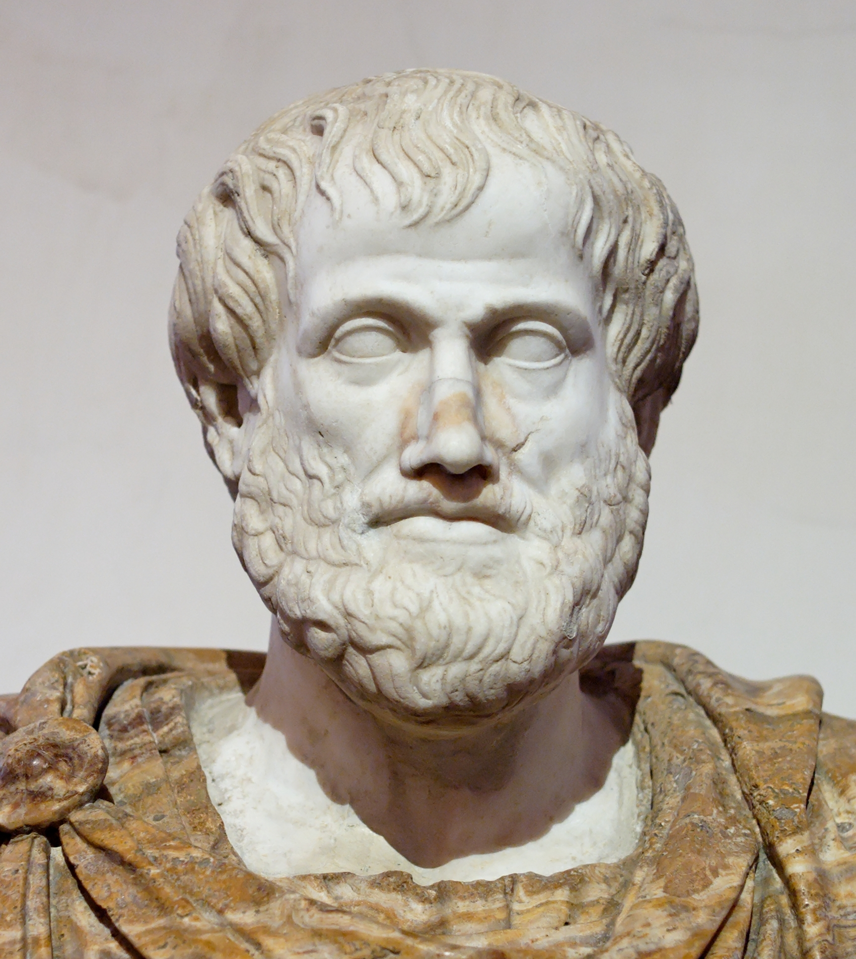
Aristotle
(384 BCE – 322 BCE)
Greek philosopher and scientist
One of the great ancient philosophers
Tutored Alexander the Great
Wrote “On Rhetoric” in 350 B.C.E
Considered the father of rhetoric

Slide 4
According to Aristotle…
There are three modes of persuasion:
Ethos
Pathos
Logos

Slide 5
Ethos, Pathos, Logos
Appeal to Ethics and Credibility
Based on the speaker or author
Is the author reliable and credible?
Is the author knowledgeable?
Appeal to Emotions
Based on how the text makes the reader/audience feel
How does the text make the audience feel?
Appeal to Logic and Reason
Based on facts, research, and evidence
How do the facts and evidence support the claim?

Slide 6
Ethos
Ethos is an effective argumentative and persuasive strategy because when the audience believes that the author is knowledgeable and genuine, the audience is more willing to listen and be persuaded.

Slide 7
Ethos
Ask these questions to determine Ethos
Does the writer/speaker seem trustworthy?
Does the writer/speaker seem knowledgeable?
How does the writer/speaker establish credibility and authority?

Slide 8
Ethos Examples
Dr. Martin Luther King Jr.’s “Letter from the Birmingham Jail” is effective because he established credibility as an African-American male who was in jail. It was authentic and real.
When a trusted doctor gives you medical advice, you follow it, even if you do not understand the medical reasoning behind it. This is because you trust the doctor.

Slide 9
Logos
Logos is an effective argumentative and persuasive strategy because when the audience is presented with factual, researched evidence supporting the claims, the audience is more likely to consider the claims valid.
Logos is much more important in argumentative writing than it is in persuasive writing.

Slide 10
Logos
Ask these questions to determine Logos
What claim is the author/speaker arguing?
Is the author/speaker’s evidence relevant?
Does the author/speaker include logical fallacies in his/her argument?
What evidence does the author/speaker use to support his/her claim?

Slide 11
Logos Examples
Any argument that includes logical and relevant evidence (researched data, facts, statistics, events, etc.) includes Logos.

Slide 12
Pathos
Pathos is an effective persuasive* strategy because the audience may accept claims based on how the text makes them feel, rather than factual data.
Pathos is much more important in persuasive writing than it is in argumentative writing.
*Pathos should be used sparingly in argumentative writing.

Slide 13
Pathos
Ask these questions to determine Pathos
Does the author/speaker appeal to your emotions?
What feelings do you feel when reading the text?
How did the writer establish or create a relationship with you?

Slide 14
Pathos Example
Lee Greenwood’s song God Bless the USA became very popular after the September 11 attacks.
Empathizing with a friend who is experiencing a break up.

Slide 15
Which One Is It?
You cannot put a price on your safety. That is why you should buy this state-of-the-art home security system.
?

Slide 16
Which One Is It?
You cannot put a price on your safety. That is why you should buy this state-of-the-art home security system.
Pathos

Slide 17
Which One Is It?
Our company has been around for almost 150 years. We are the industry’s leader when it comes to engines.
?

Slide 18
Which One Is It?
Our company has been around for almost 150 years. We are the industry’s leader when it comes to engines.
Ethos

Slide 19
Which One Is It?
As a country, we should invest in public education because children are our future. We need to invest in our children –in our future.
?

Slide 20
Which One Is It?
As a country, we should invest in public education because children are our future. We need to invest in our children –in our future.
Ethos

Slide 21
Which One Is It?
Despite consumer resistance, companies continue to test products on animals because studies show that animal testing is safe and reliable.
?

Slide 22
Which One Is It?
Despite consumer resistance, companies continue to test products on animals because studies show that animal testing is safe and reliable.
Logos

Slide 23
Which One Is It?
The young mother has trouble providing her small children with clothing and food. She is an excellent mother who does her best, but sometimes she has a difficult time making ends meet.
?

Slide 24
Which One Is It?
The young mother has trouble providing her small children with clothing and food. She is an excellent mother who does her best, but sometimes she has a difficult time making ends meet.
Pathos

Slide 25
Which One Is It?
After looking at several studies that highlight the benefit of later start times for teenagers, the school district has decided to push back high school start times to 9:00 a.m.
?

Slide 26
Which One Is It?
After looking at several studies that highlight the benefit of later start times for teenagers, the school district has decided to push back high school start times to 9:00 a.m.
Logos

Slide 27
Adding in Other Persuasive Techniques
Remember, you want more fact-based evidence for argumentative writing. However, it is helpful to know persuasive techniques.

Slide 28
Persuasive Techniques
Facts and statistics
Celebrity testimonials
Bandwagon approach
Fear mongering
Glittering generalities
Loaded words
Expert testimonial
Repetition

Slide 29
Persuasive Techniques
Facts and statistics
Celebrity testimonials
Bandwagon approach
Fear mongering
Glittering generalities
Loaded words
Expert testimonial
Repetition
Researched information and evidence gives the author credibility and provides logical connections for the audience

Slide 30
Persuasive Techniques
Facts and statistics
Celebrity Testimonials
Bandwagon approach
Fear mongering
Glittering generalities
Loaded words
Expert testimonial
Repetition
When a celebrity endorses a product rather than an expert, people are more likely to act on emotions. If you use the same face wash as a celebrity, you too will look that great.

Slide 31
Persuasive Techniques
Facts and statistics
Celebrity testimonials
Bandwagon Approach
Fear mongering
Glittering generalities
Loaded words
Expert testimonial
Repetition
If everyone else is doing something or owns a particular item, you should too, so that you are not left behind.

Slide 32
Persuasive Techniques
Facts and statistics
Celebrity testimonials
Bandwagon approach
Fear Mongering
Glittering generalities
Loaded words
Expert testimonial
Repetition
Creating fear in someone to convince them to believe in something they otherwise might not, or to convince them to buy a certain product.

Slide 33
Persuasive Techniques
Facts and statistics
Celebrity testimonials
Bandwagon approach
Fear mongering
Glittering Generalities
Loaded words
Expert testimonial
Repetition
Using positive and “glittery” loaded words so that people feel good about their beliefs, purchases, and opinions.

Slide 34
Persuasive Techniques
Facts and statistics
Celebrity testimonials
Bandwagon approach
Fear mongering
Glittering generalities
Loaded Words
Expert testimonial
Repetition
When an author, speaker, or advertiser carefully chooses their words (diction) to create a certain (and often times emotional) response from the audience.

Slide 35
Persuasive Techniques
Facts and statistics
Celebrity testimonials
Bandwagon approach
Fear mongering
Glittering generalities
Loaded words
Expert Testimonial
Repetition
An author or speaker establishes credibility when he/she is an expert in the field.

Slide 36
Persuasive Techniques
Facts and statistics
Celebrity testimonials
Bandwagon approach
Fear mongering
Glittering generalities
Loaded words
Expert testimonial
Repetition
Repeating words and phrases over and over and over again will help people remember things and it may also evoke certain feelings in the audience.

Slide 37
Persuasive Techniques in Relation to Ethos, Pathos, and Logos
Logos
A sensible and logical argument built on relevant and sufficient evidence.
Facts and statistics
Claims based on general logic
Appeals
These three RHETORICAL APPEALS make up the rhetorical triangle.
Pathos
Arguments built in a way that will evoke certain emotions in the audience
Celebrity testimonials
Bandwagon approach
Fear mongering
Glittering generalities
Loaded words
Repetition
Ethos
A well-researched and thoroughly developed argument
Expert testimonial
Trustworthiness
Credibility

